Slide 1


INT213 PROJECT
Characters Identify Game
SAGAR PANDEY
SUBMITTED TO :
GROUP MEMBERS :
AKSHAT (ROLL - 28)
VIBHAV SINGH (ROLL -23)
SIDDHANT SHARMA (ROLL -31)
SECTION - K19HZ, GROUP - 1

Slide 2
CONTENTS
INTRODUCTION
LIBRARIES USED
WORKING
SCREENSHORT
REFERENCE

Slide 3
INTRODUCTION
GUI INTERFACE IS USED
DISPLAY THE RANDOM IMAGES
EVERY TIME USER PLAY DISPLAY RANDOM SET OF IMAGE
USER HAVE TO ENTER THE ANSWER AS PER THE QUESTION
CHAT BOT WILL BE PROVIDED FOR HELP OR HINT
EVERY CORRECT ANSWER GIVES YOU TWO POINT
BUT IF USER USES CHAT BOT FOR HINT IT WILL GIVE YOU NEGATIVE MARKING
DISPLAY FINAL SCORE

Slide 4
PYTHON LIBRARIES
TKINTER LIBRARY
PYTHON PILLOW IS USED TO DISPLAY IMAGES
RANDOM FUNCTION IS USED TO DISPLAY RANDOM SET OF QUESTION
WINSOUND LIBRARIES IS USED TO PLAY BACKGROUND MUSIC
PYTTSX3 LIBRARY FOR SPEAK FUNCTION
CHATTERBOT LIBRARY FOR CHAT BOT

Slide 5
WORKING
USER CAN CLICK ON START BUTTON TO START THE GAME
10 RANDOM QUISTION WILL BE DISPLAY ONE BY ONE
USER HAVE TO TYPE THE ANSWER
EACH CORRECT ANSWER WILL GIVES THEM ONE MARKS
USER CAN USER CHAT BOT FOR HINT
BUT USING CHAT BOT HINT WILL GIVE THEM .25 NEGATIVE MARKING
NO MARKS FOR UNATTEMPETED QUESTION
FINAL SCORE WILL BE DISPLAY

Slide 6
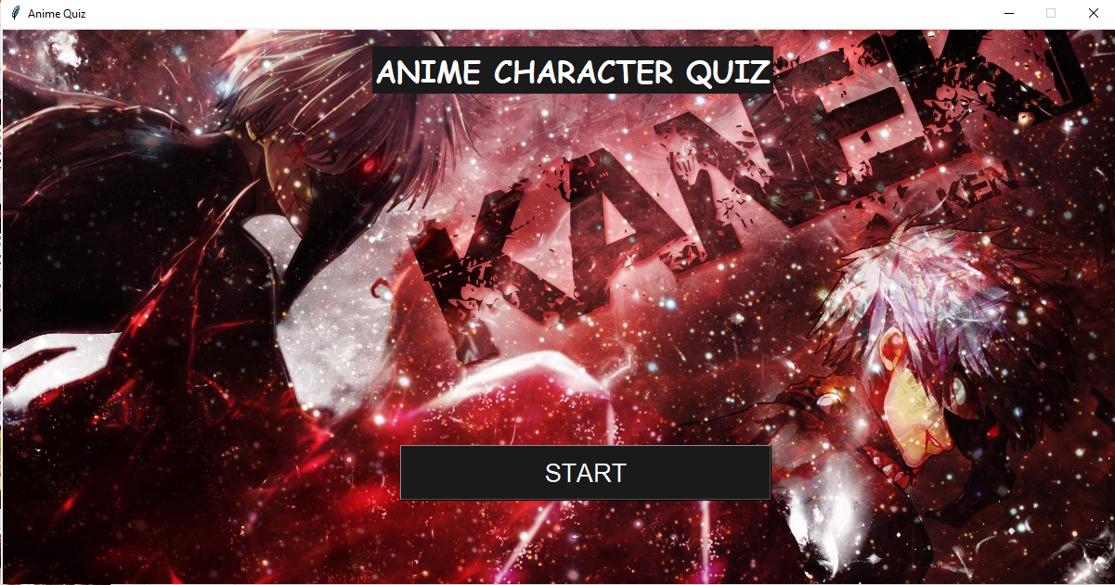
SCREENSHORT

Slide 7
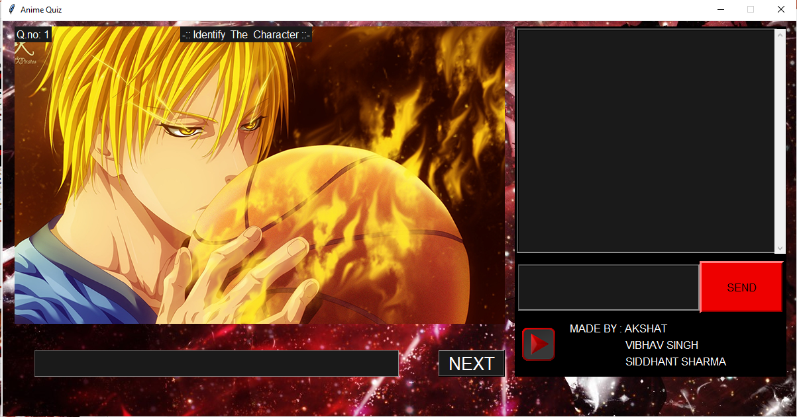

Slide 8
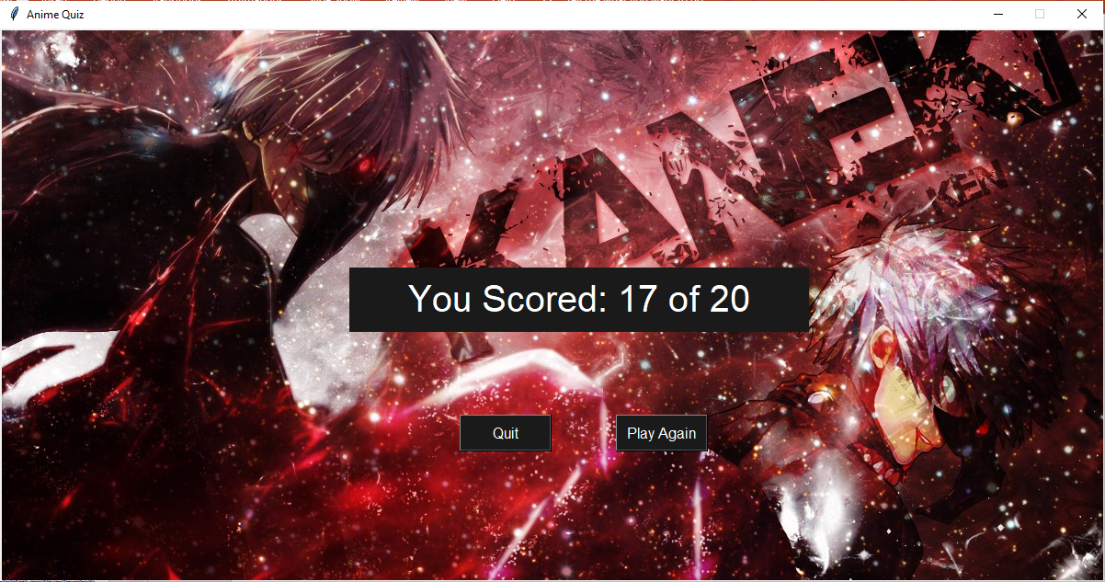

Slide 9
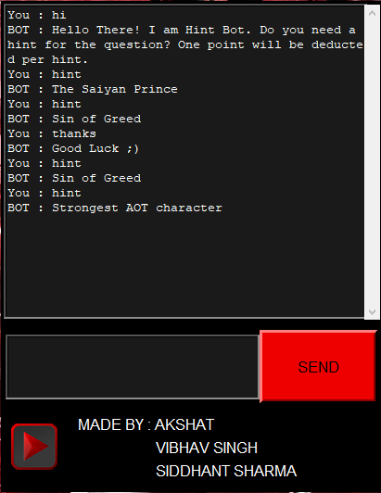
BOT
You can always ask the Bot for help.
But it will cost you -0.5 points
As a penalty
At the end we placed our names

Slide 10
REFERENCES
https://www.geeksforgeeks.org/gui-chat-application-using-tkinter-in-python/
https://www.geeksforgeeks.org/working-images-python/
https://www.geeksforgeeks.org/python-winsound-module/
https://www.geeksforgeeks.org/python-text-to-speech-by-using-pyttsx3/

Slide 11


